Slide 1
Nonlinear Equations

Slide 2
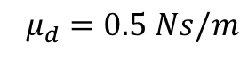
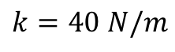
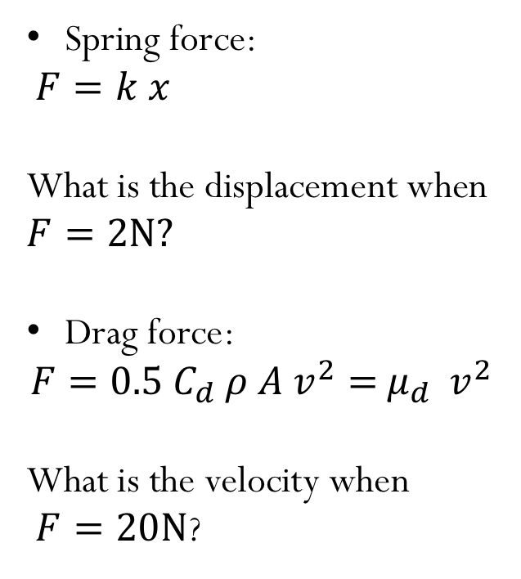
How can we solve these equations?
$$k=40 N/m$$
Spring force:
$$F=k x$$
What is the displacement when $F=2N?$
Drag force:
$$F={0.5 C}_{d} ρ {A v}^{2}={ μ}_{d} { v}^{2}$$
What is the velocity when
$F=20N$?
$${ μ}_{d} =0.5 Ns/m$$
Notes:
Cd: drag coefficient, rho: density of the fluid, A: cross section area, speed of the object
Spring x = 0.05m
Drag v = 6.3 m/s

Slide 3
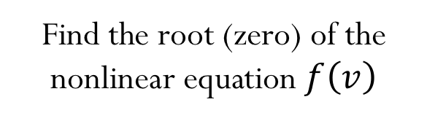
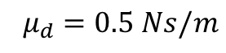
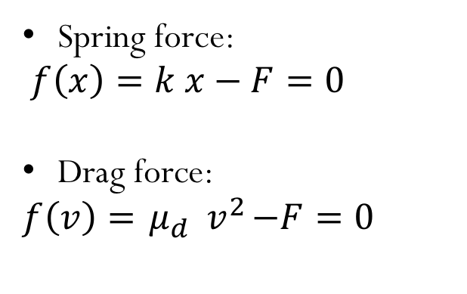
Spring force:
$$f\left(x\right)=k x−F=0$$
Drag force:
$$f\left(v\right)={ μ}_{d} { v}^{2}−F=0$$
$${ μ}_{d} =0.5 Ns/m$$
Find the root (zero) of the nonlinear equation $f\left(v\right)$
Nonlinear Equations in 1D
Goal: Solve $f\left(x\right)=0$ for $f:ℛ→ℛ$
Often called Root Finding

Slide 4
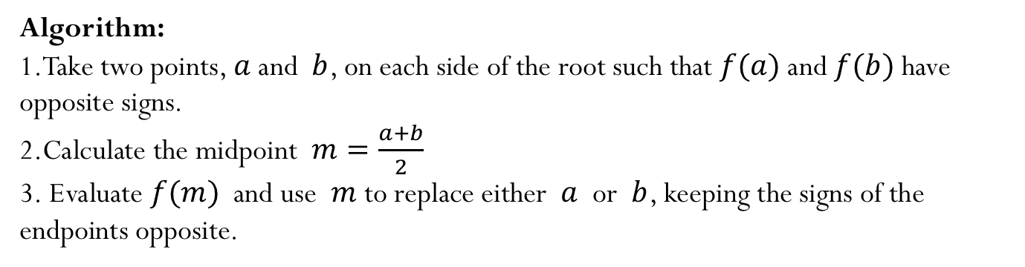
Bisection method
Algorithm:
Take two points, $a$ and $b$, on each side of the root such that $f(a)$and $f(b)$have opposite signs.
Calculate the midpoint $m=\frac{a+b}{2}$
Evaluate $f(m)$ and use $m$ to replace either $a$ or $b$, keeping the signs of the endpoints opposite.

Slide 5
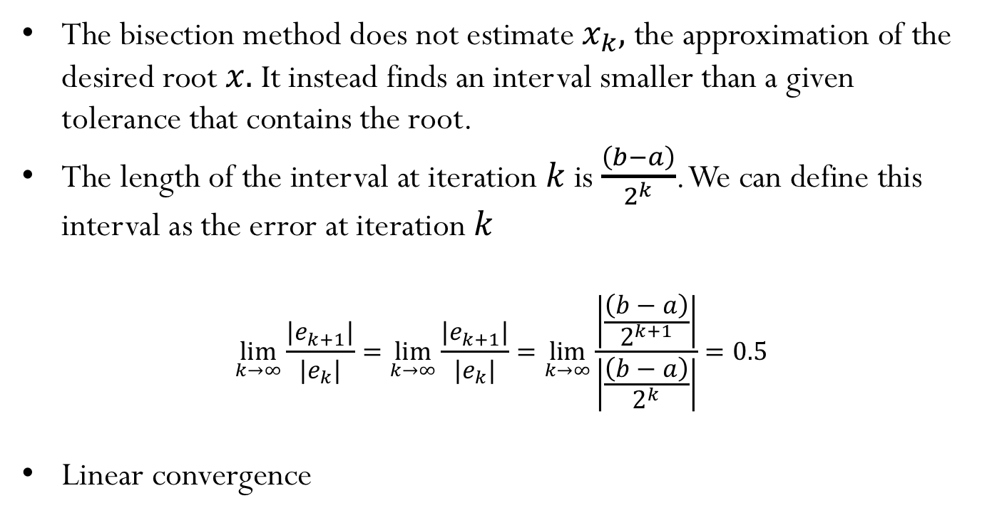
Convergence
The bisection method does not estimate${ x}_{k},$ the approximation of the desired root $x.$ It instead finds an interval smaller than a given tolerance that contains the root.
The length of the interval at iteration $k$ is $\frac{\left(b−a\right)}{2^{k}}$. We can define this interval as the error at iteration $k$
$$\lim_{k→∞}{\frac{|e_{k+1}|}{|e_{k}|}}=\lim_{k→∞}{\frac{|e_{k+1}|}{|e_{k}|}}=\lim_{k→∞}\frac{\left|\frac{\left(b−a\right)}{2^{k+1}}\right|}{\left|\frac{\left(b−a\right)}{2^{k}}\right|}=0.5$$
Linear convergence

Slide 6
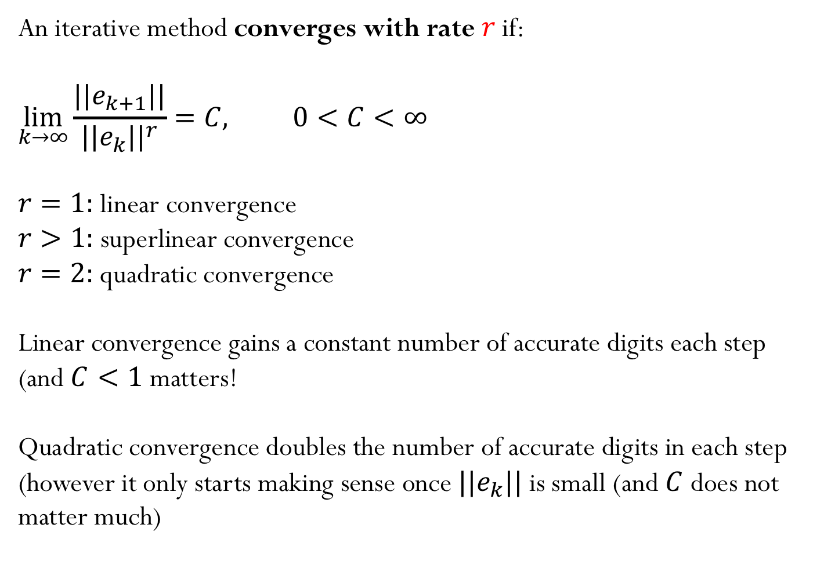
Convergence
An iterative method converges with rate $r$if:
$$\lim_{k→∞}{\frac{||e_{k+1}||}{{||e_{k}||}^{r}}=C, 0<C<∞}$$
$r=1:$ linear convergence
$r>1:$ superlinear convergence
$r=2:$ quadratic convergence
Linear convergence gains a constant number of accurate digits each step (and $C<1$ matters!
Quadratic convergence doubles the number of accurate digits in each step (however it only starts making sense once $||e_{k}||$is small (and $C$ does not matter much)

Slide 7
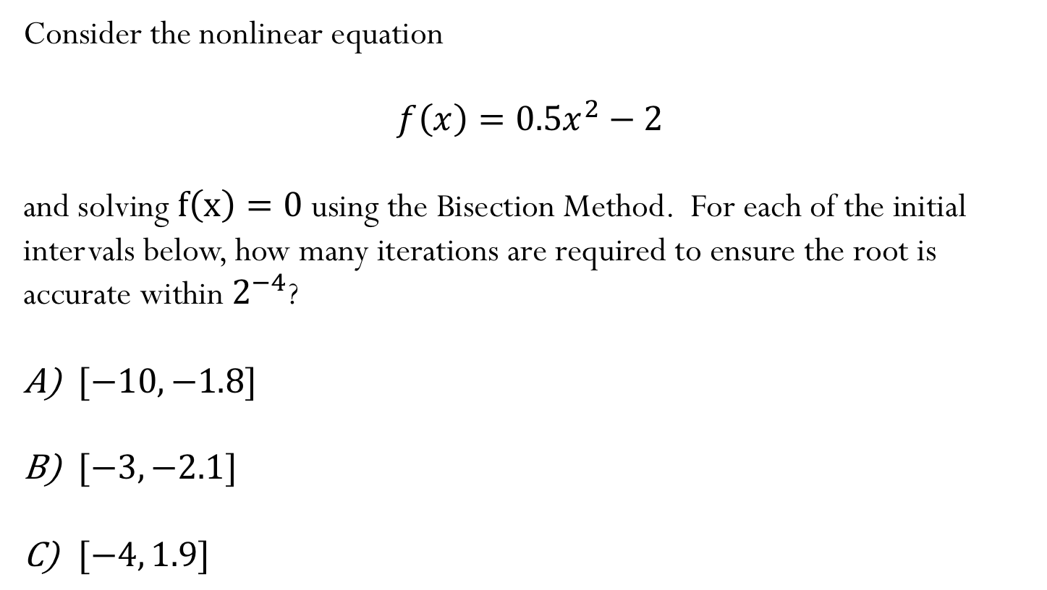
Example:
Consider the nonlinear equation
$$f\left(x\right)=0.5x^{2}−2$$
and solving $f\left(x\right)=0$ using the Bisection Method. For each of the initial intervals below, how many iterations are required to ensure the root is accurate within $2^{−4}$?
$[−10,−1.8]$
$[−3,−2.1]$
$[−4, 1.9]$
Notes:
Signs differ, length = 8.2, takes 8 iterations (requires more iterations even tough -1.8 is very close to root -2)
Signs don’t differ (not valid interval), so not best even tough shortest interval
Signs differ, length = 3.5, takes 6 iterations
Signs differ length = 5.9, takes 7 iterations

Slide 8
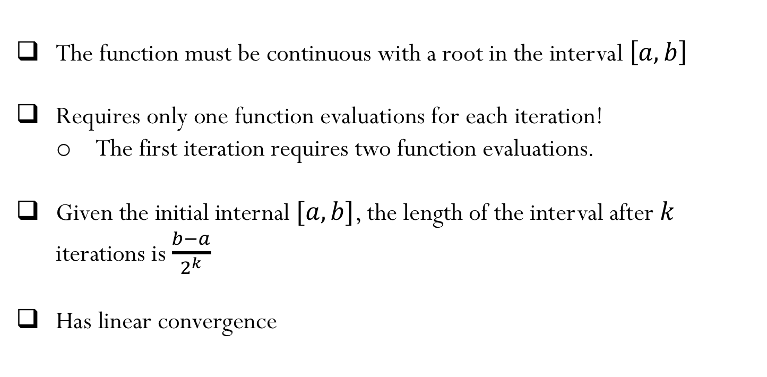
Bisection Method - summary
The function must be continuous with a root in the interval $\left[a,b\right]$
Requires only one function evaluations for each iteration!
The first iteration requires two function evaluations.
Given the initial internal $[a,b]$, the length of the interval after $k$ iterations is $\frac{b−a}{2^{k}}$
Has linear convergence

Slide 9
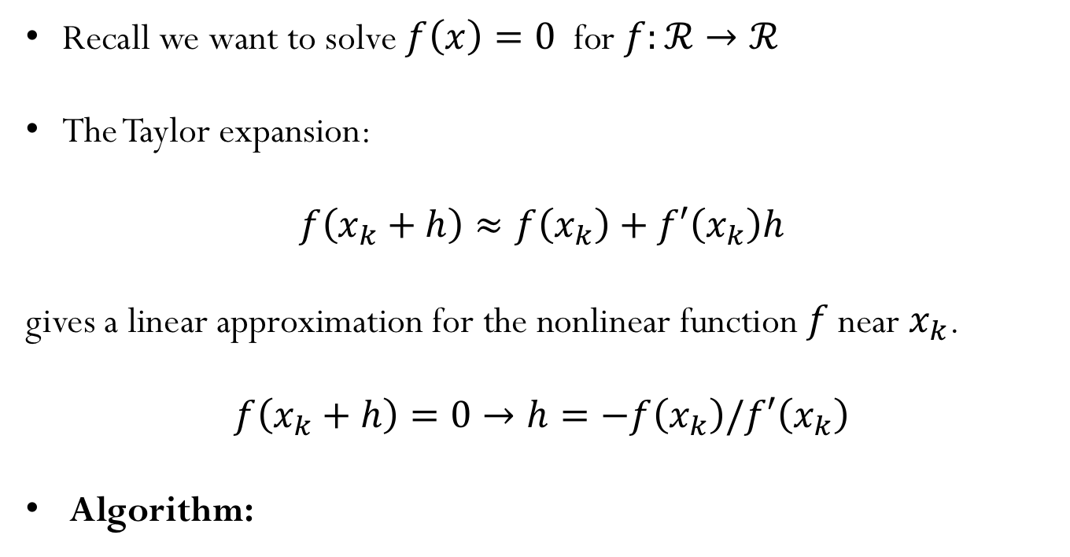
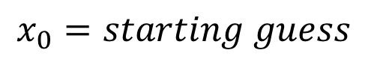
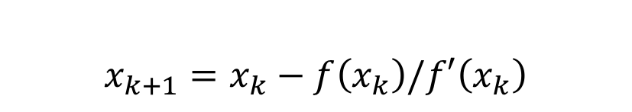
Newton’s method
Recall we want to solve $f\left(x\right)=0$ for $f:ℛ→ℛ$
The Taylor expansion:
$$f\left(x_{k}+h\right)≈f\left(x_{k}\right)+f′\left(x_{k}\right)h$$
gives a linear approximation for the nonlinear function $f$ near $x_{k}$.
$$f\left(x_{k}+h\right)=0→h=−f\left(x_{k}\right)/f′\left(x_{k}\right)$$
Algorithm:
$$x_{0}=starting guess$$
$$x_{k+1}=x_{k}−f\left(x_{k}\right)/f′\left(x_{k}\right)$$

Slide 10
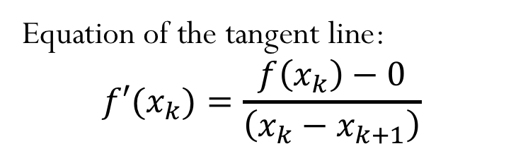
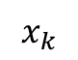
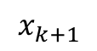
Newton’s method
Equation of the tangent line:
$$f′(x_{k})=\frac{f\left(x_{k}\right)−0}{\left(x_{k}−x_{k+1}\right)}$$
$$x_{k+1}$$
$$x_{k}$$

Slide 11
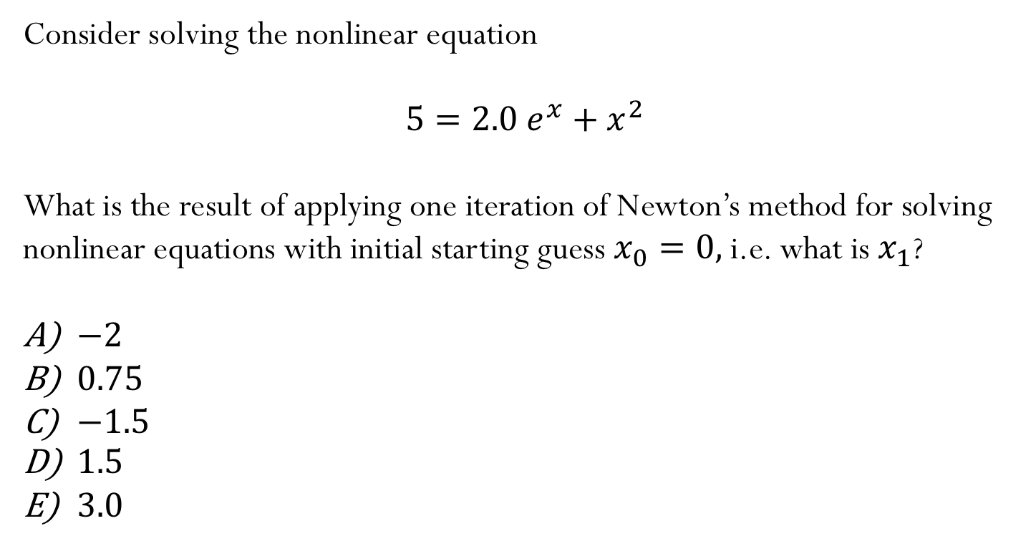
Iclicker question
Consider solving the nonlinear equation
$$5=2.0 e^{x}+x^{2}$$
What is the result of applying one iteration of Newton’s method for solving nonlinear equations with initial starting guess $x_{0}=0,$i.e. what is $x_{1}$?
$−2$
$0.75$
$−1.5$
$1.5$
$3.0$

Slide 12
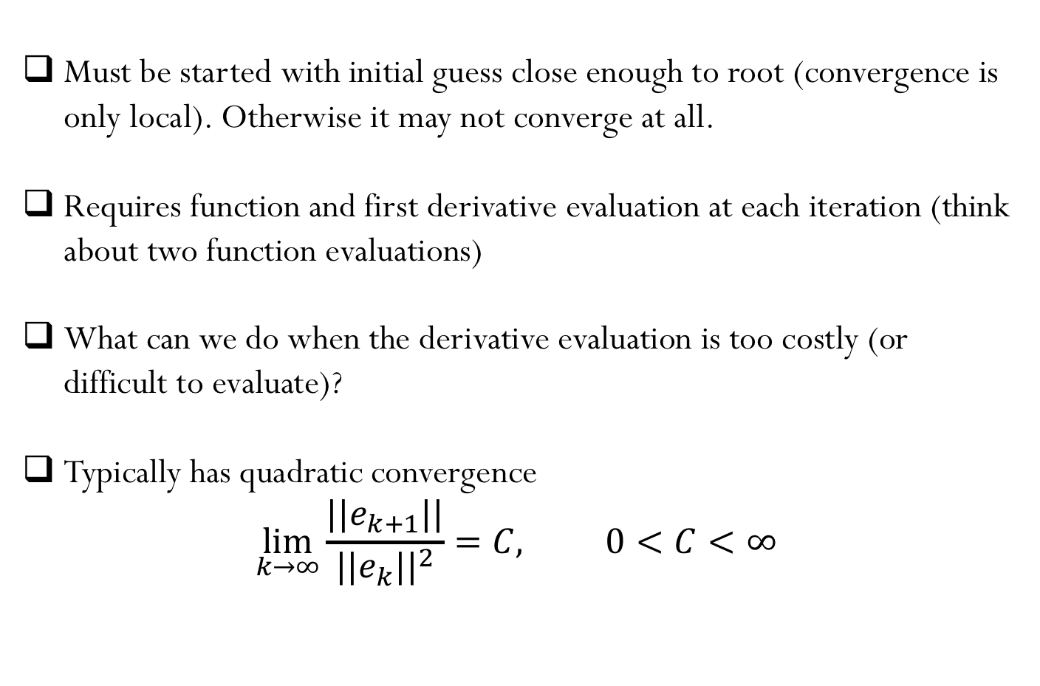
Newton’s Method - summary
Must be started with initial guess close enough to root (convergence is only local). Otherwise it may not converge at all.
Requires function and first derivative evaluation at each iteration (think about two function evaluations)
What can we do when the derivative evaluation is too costly (or difficult to evaluate)?
Typically has quadratic convergence
$$\lim_{k→∞}{\frac{||e_{k+1}||}{{||e_{k}||}^{2}}=C, 0<C<∞}$$

Slide 13
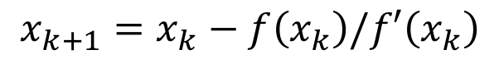
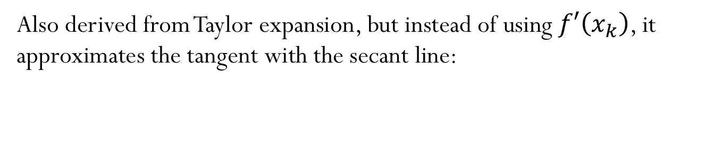
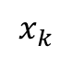
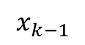
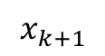
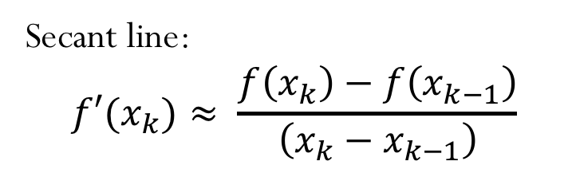
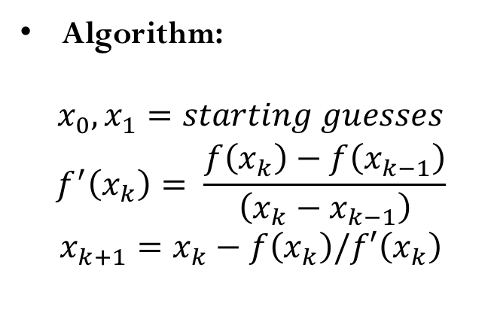
Secant method
Also derived from Taylor expansion, but instead of using $f′\left(x_{k}\right)$, it approximates the tangent with the secant line:
$$x_{k+1}=x_{k}−f\left(x_{k}\right)/f′\left(x_{k}\right)$$
Secant line:
$$f′(x_{k})≈ \frac{f\left(x_{k}\right)−f\left(x_{k−1}\right)}{\left(x_{k}−x_{k−1}\right)}$$
Algorithm:
$$x_{0},x_{1}=starting guesses$$
$$f^{′}\left(x_{k}\right)= \frac{f\left(x_{k}\right)−f\left(x_{k−1}\right)}{\left(x_{k}−x_{k−1}\right)}$$
$$x_{k+1}=x_{k}−f\left(x_{k}\right)/f′\left(x_{k}\right)$$
$$x_{k+1}$$
$$x_{k}$$
$$x_{k−1}$$

Slide 14
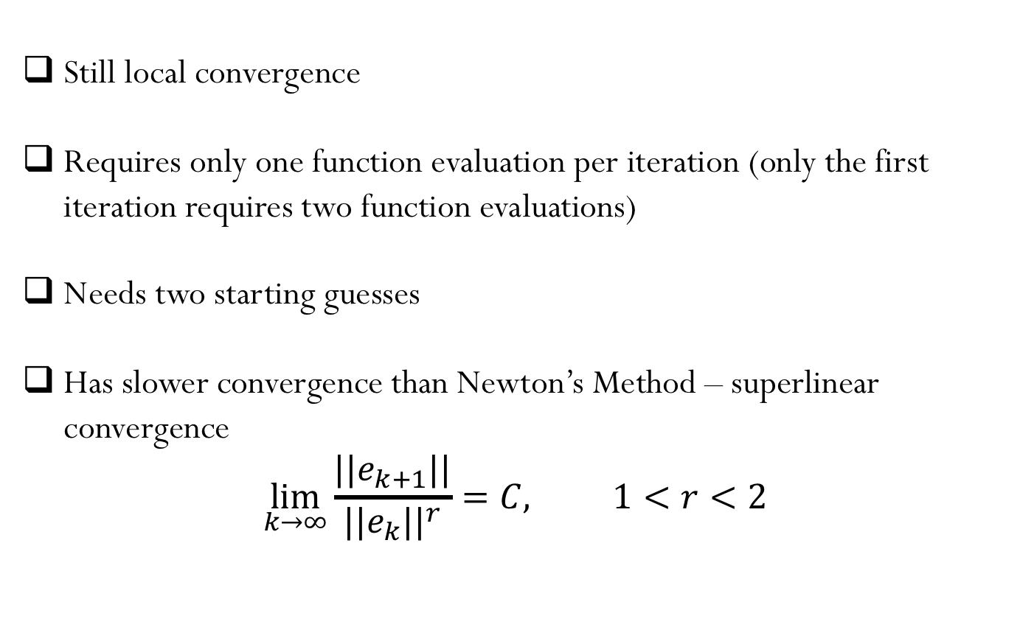
Secant Method - summary
Still local convergence
Requires only one function evaluation per iteration (only the first iteration requires two function evaluations)
Needs two starting guesses
Has slower convergence than Newton’s Method – superlinear convergence
$$\lim_{k→∞}{\frac{||e_{k+1}||}{{||e_{k}||}^{r}}=C, 1<r<2}$$

Slide 15
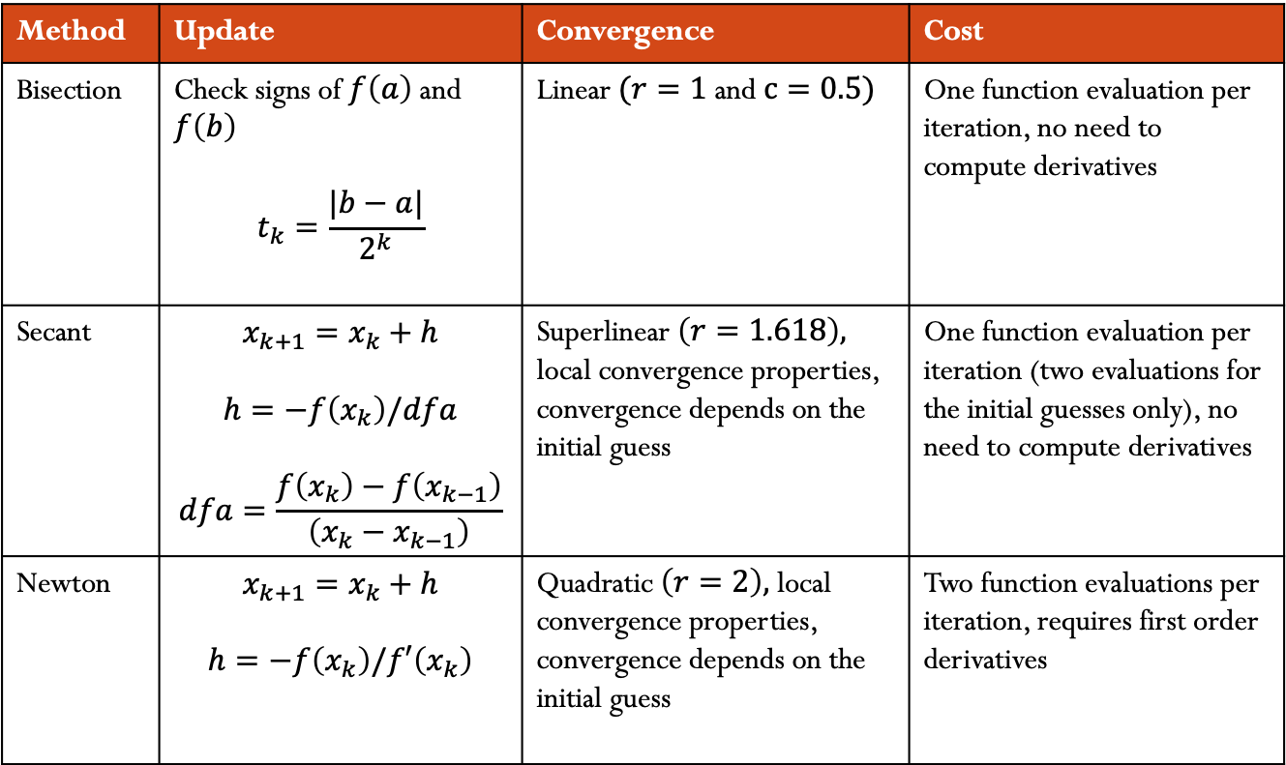
1D methods for root finding:
Method | Update | Convergence | Cost
Bisection | Check signs of $f\left(a\right)$and $f\left(b\right)$ $$t_{k}=\frac{|b−a|}{2^{k}}$$ | Linear $(r=1$and $c=0.5)$ | One function evaluation per iteration, no need to compute derivatives
Secant | $$x_{k+1}=x_{k}+h$$ $$h=−f\left(x_{k}\right)/dfa$$ $$dfa=\frac{f\left(x_{k}\right)−f\left(x_{k−1}\right)}{\left(x_{k}−x_{k−1}\right)}$$ | Superlinear $\left(r=1.618\right),$ local convergence properties, convergence depends on the initial guess | One function evaluation per iteration (two evaluations for the initial guesses only), no need to compute derivatives
Newton | $$x_{k+1}=x_{k}+h$$ $$h=−f\left(x_{k}\right)/f′\left(x_{k}\right)$$ | Quadratic $\left(r=2\right),$ local convergence properties, convergence depends on the initial guess | Two function evaluations per iteration, requires first order derivatives

Slide 16

Nonlinear system of equations

Slide 17
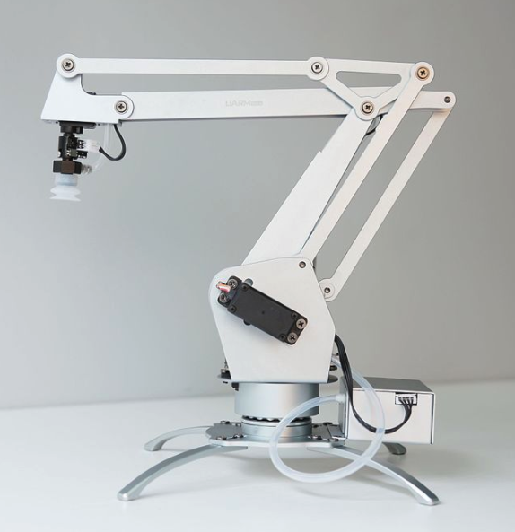
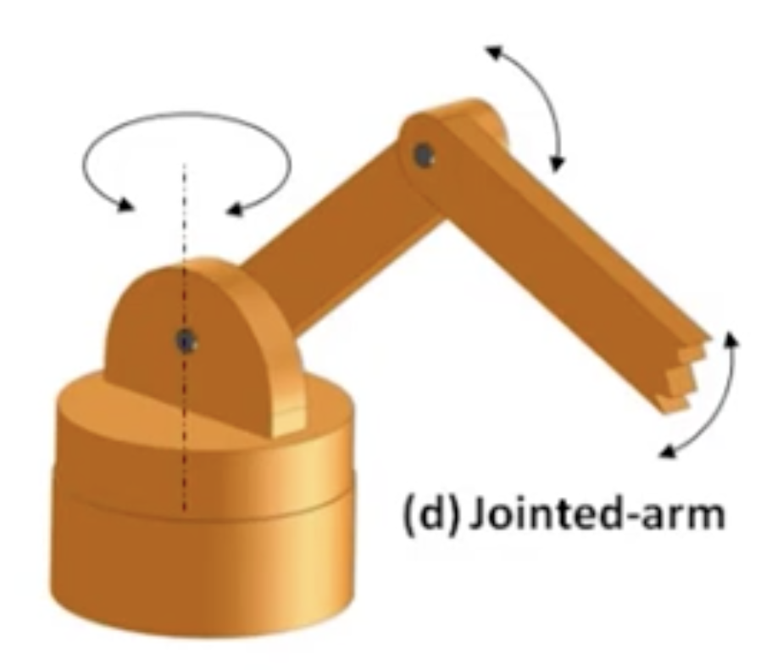
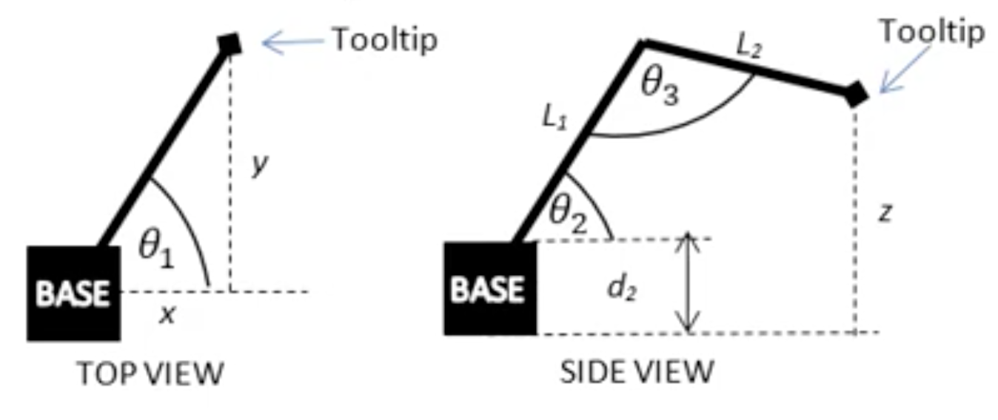
Robotic arms
https://www.youtube.com/watch?v=NRgNDlVtmz0 (Robotic arm 1)
https://www.youtube.com/watch?v=9DqRkLQ5Sv8 (Robotic arm 2)
https://www.youtube.com/watch?v=DZ_ocmY8xEI (Blender)

Slide 18
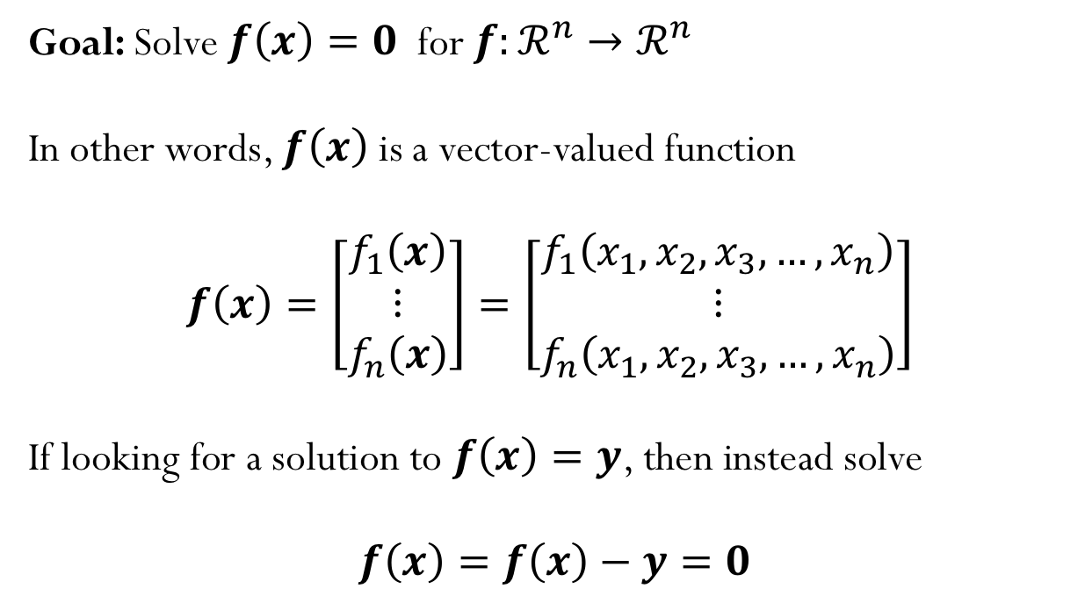
Nonlinear system of equations
Goal: Solve $f\left(x\right)=0$ for $f:ℛ^{n}→ℛ^{n}$
In other words, $f\left(x\right)$ is a vector-valued function
$$f\left(x\right)=\left[\begin{matrix}f_{1}\left(x\right) \\ ⋮ \\ f_{n}\left(x\right)\end{matrix}\right]=\left[\begin{matrix}f_{1}\left(x_{1},x_{2},x_{3},…,x_{n}\right) \\ ⋮ \\ f_{n}\left(x_{1},x_{2},x_{3},…,x_{n}\right)\end{matrix}\right]$$
If looking for a solution to $f\left(x\right)=y$, then instead solve
$f\left(x\right)=f\left(x\right)−y=0$

Slide 19
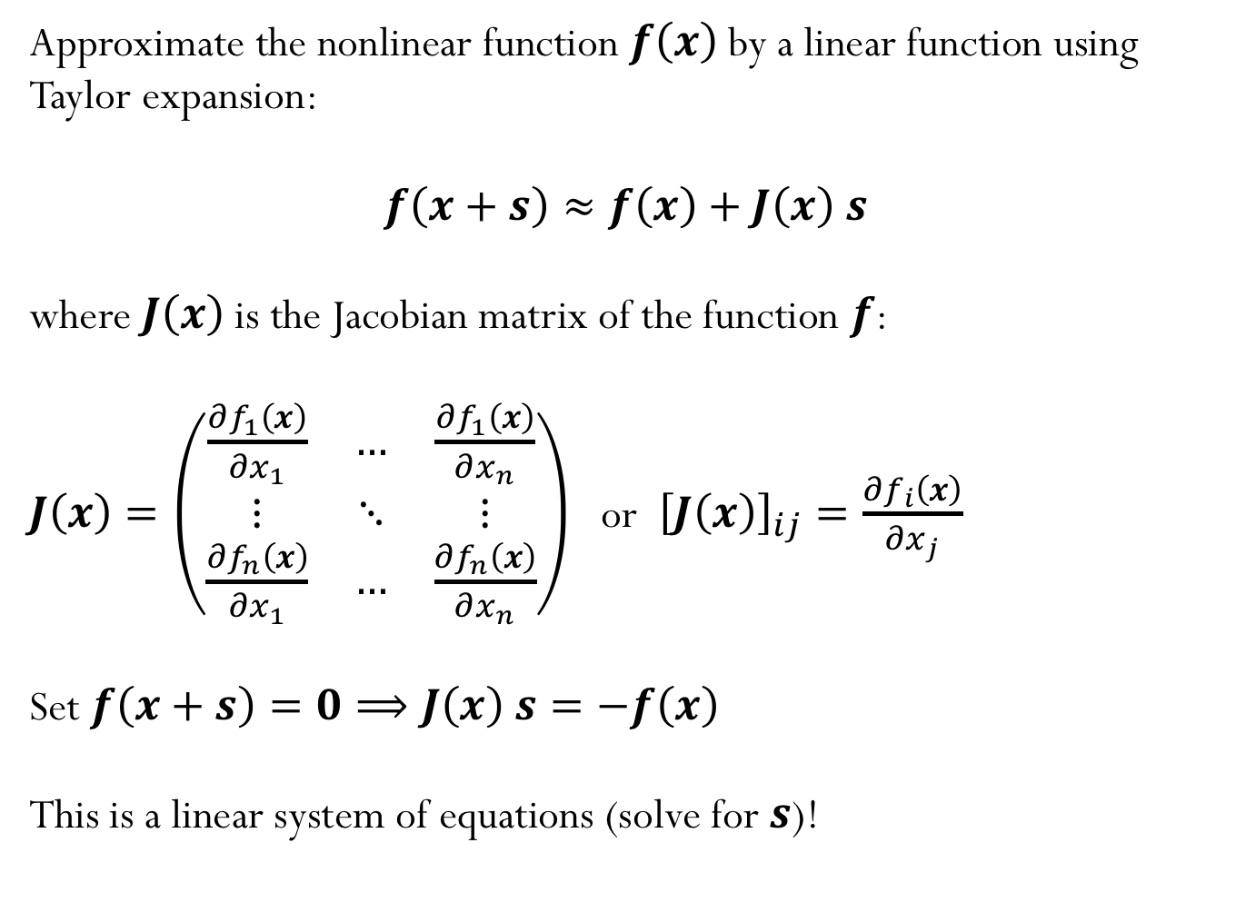
Newton’s method
Approximate the nonlinear function $f\left(x\right)$by a linear function using Taylor expansion:
$$f\left(x+s\right)≈f\left(x\right)+J\left(x\right) s$$
where $J\left(x\right)$is the Jacobian matrix of the function $f$:
$J\left(x\right)=\left(\begin{matrix}\frac{∂f_{1}\left(x\right)}{∂x_{1}} & … & \frac{∂f_{1}\left(x\right)}{∂x_{n}} \\ ⋮ & ⋱ & ⋮ \\ \frac{∂f_{n}\left(x\right)}{∂x_{1}} & … & \frac{∂f_{n}\left(x\right)}{∂x_{n}}\end{matrix}\right)$ or ${\left[J\left(x\right)\right]}_{ij}=\frac{∂f_{i}\left(x\right)}{∂x_{j}}$
Set $f\left(x+s\right)=0⟹J\left(x\right) s=−f\left(x\right)$
This is a linear system of equations (solve for $s$)!

Slide 20
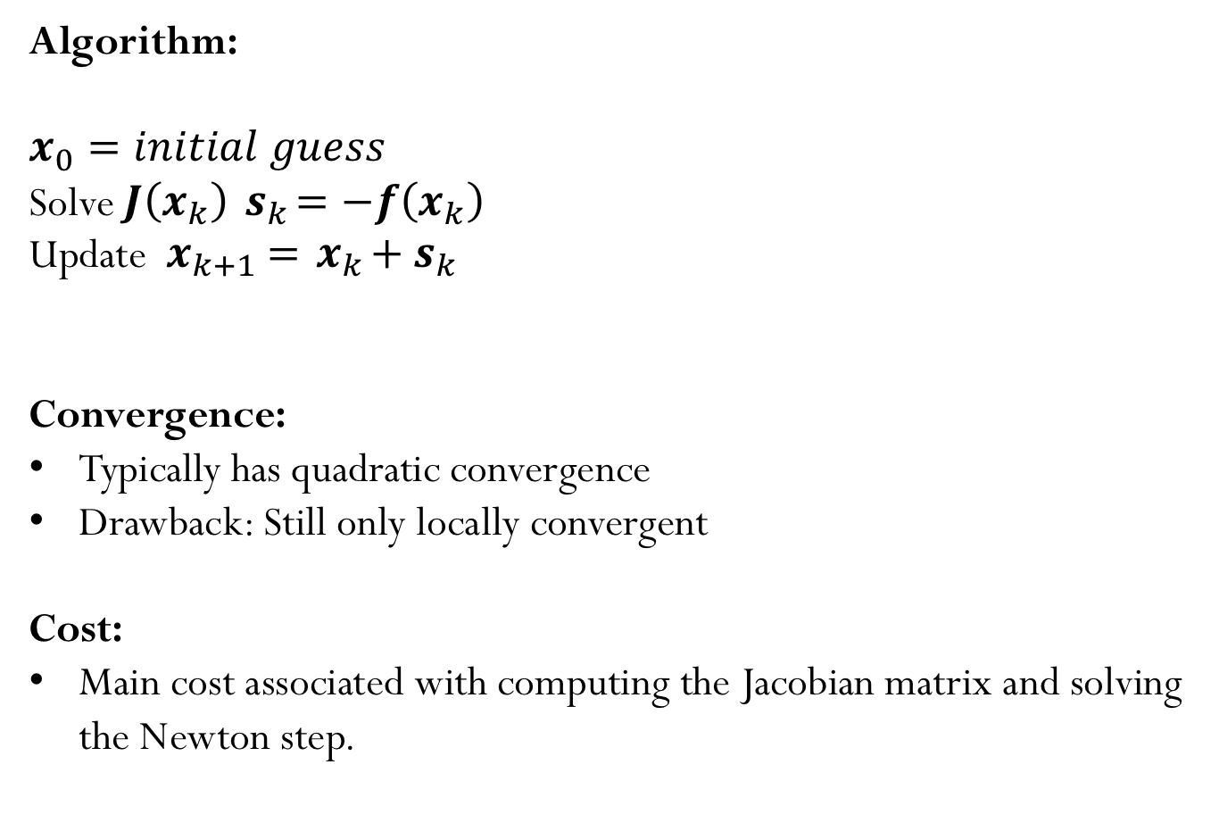
Newton’s method
Algorithm:
$$x_{0}=initial guess$$
Solve $J\left(x_{k}\right){ s}_{k}=−f\left(x_{k}\right)$
Update ${{ x}_{k+1} ={ x}_{k}+ s}_{k}$
Convergence:
Typically has quadratic convergence
Drawback: Still only locally convergent
Cost:
Main cost associated with computing the Jacobian matrix and solving the Newton step.

Slide 21
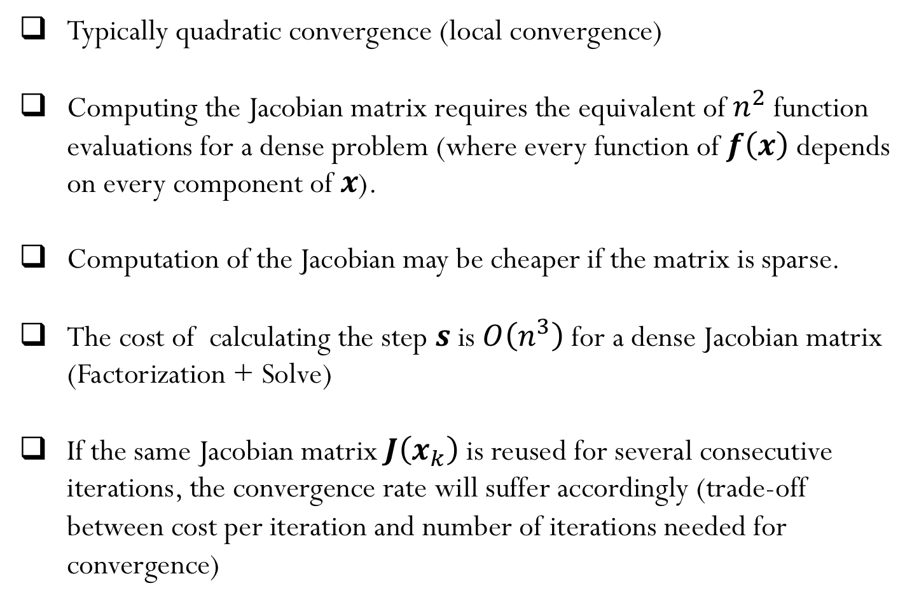
Newton’s method - summary
Typically quadratic convergence (local convergence)
Computing the Jacobian matrix requires the equivalent of $n^{2}$ function evaluations for a dense problem (where every function of $f\left(x\right)$ depends on every component of $x$).
Computation of the Jacobian may be cheaper if the matrix is sparse.
The cost of calculating the step $s$ is $O\left(n^{3}\right)$ for a dense Jacobian matrix (Factorization + Solve)
If the same Jacobian matrix $J\left(x_{k}\right)$ is reused for several consecutive iterations, the convergence rate will suffer accordingly (trade-off between cost per iteration and number of iterations needed for convergence)
Notes:
Comment about Secant methods where Jacobian is approximated to avoid need to calculate derivatives

Slide 22
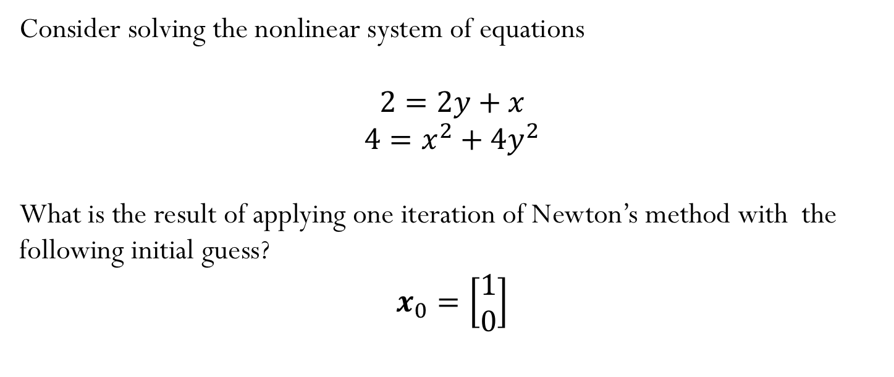
Example
Consider solving the nonlinear system of equations
$$2=2y+x$$
$$4=x^{2}+{4y}^{2}$$
What is the result of applying one iteration of Newton’s method with the following initial guess?
$$x_{0}=\left[\begin{matrix}1 \\ 0\end{matrix}\right]$$

Slide 23
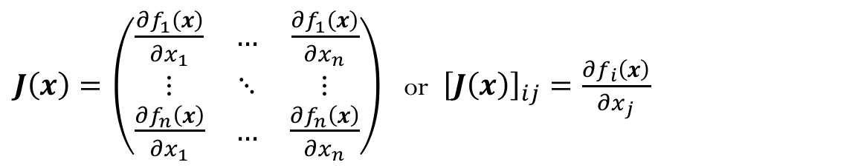
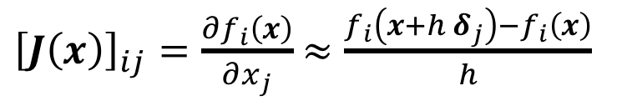
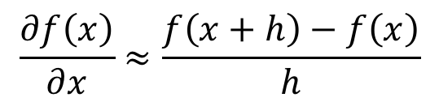
Finite Difference
Find an approximate for the Jacobian matrix:
$J\left(x\right)=\left(\begin{matrix}\frac{∂f_{1}\left(x\right)}{∂x_{1}} & … & \frac{∂f_{1}\left(x\right)}{∂x_{n}} \\ ⋮ & ⋱ & ⋮ \\ \frac{∂f_{n}\left(x\right)}{∂x_{1}} & … & \frac{∂f_{n}\left(x\right)}{∂x_{n}}\end{matrix}\right)$ or ${\left[J\left(x\right)\right]}_{ij}=\frac{∂f_{i}\left(x\right)}{∂x_{j}}$
In 1D:
$$\frac{∂f\left(x\right)}{∂x}≈\frac{f\left(x+h\right)−f\left(x\right)}{h}$$
In ND:
${\left[J\left(x\right)\right]}_{ij}=\frac{∂f_{i}\left(x\right)}{∂x_{j}}$ $≈\frac{f_{i}\left(x+h{ δ}_{j}\right)−f_{i}\left(x\right)}{h}$

